Slide 1
Jackson v. State
Court of Appeals of Maryland
February 27, 1918

Slide 2
Ordinance No. 654
Approved by Mayor Mahool April 7, 1911
First law in the nation to segregate housing by race
Source: Appellant brief, October 1915 term MD Court of Appeals
Notes:
-Very first ordinance in the US segregating housing by race
-Messed up a city council rule during its passage, so passed the next one
-Signed by Mayor J. Barry Mahool

Slide 3
Baltimore Sun 9/28/10
“Many Favor Segregation”
Councilman Milton Dashiell authored segregation and pushed for its passage
Dashiell: “would stand any test of constitutionality”
Notes:
The sun seems to think the segregation ordinance is something the majority of the city is into, and is constitutionally sound

Slide 4
The Afro-American 10/8/10 & 6/3/11
Notes:
Meanwhile, the afro covers the protests and has editorials describing the law as wicked

Slide 5
Ordinance 692
Approved May 15, 1911
Section 1: unlawful for a white person to live in a building located on a block where colored persons reside
Section 2: unlawful for a black person to live in a building located on a block where white persons reside
Sections 8 & 9: no buildings shall be used as churches or schools by white people where the building is located in a black block, and vice versa
Sources: Opinion of the Baltimore City Solicitor, October 1919 ; State v. Gurry 121 MD 534
Notes:
- ordinance 654 was re-ordained as ordinance 692, so that it complied w the req of the city council
-title: “an ordinance for preserving peace, preventing conflict and ill feeling between the white and colored races in baltimore city, and promoting the general welfare of the city by providing so far as is practicable, for the use of separateblocks by white and colored people for residences, churches and schools.”
-Exceptions for servants, and churches/ schools already in place before the ordinance passed

Slide 6
Ordinance 692: Overturned in State v. Gurry
Court of Appeals of Maryland
Decided October 7, 1913
Sources: Opinion of the Baltimore City Solicitor, October 1919 ; State v. Gurry 121 MD 534
Notes:
-Ct of app found it was clear that the meaning of “ occupied in whole or in part by wt persons” – meant to prohibit a person of 1 race from moving into a block wholly occupied by the other.
-City can exercise its police power to preserve the peace and safety of its citizens
-held invalid bc it infringed on vested property rights of owners on designated blocks- could be used to prohibit them from living in their already-owned property or renting it to persons of one or the other race

Slide 7
Afro-American 8/9/13
Notes:
Couldn’t find anything in the baltimore sun on the gurry decision
-ordinance was overturned, and they knew that the city would try to come up with a new segregation ordinance

Slide 8
Ordinance No. 339
Approved September 15, 1913
Section 1: Prohibitions
Added: “… nothing herein contained will be construed or operate to prevent any person who, at the date of the passage of this ordinance, shall have acquired a legal right to occupy as a residence…”
Source: Appellant brief, October 1915 term MD Court of Appeals,
Notes:
-specifically worded to address the constitutional objections that the court of appeals had to ordinance 692
-Purpose: to prevent conflict and ill-feeling between the white and colored races in baltimore city, and to preserve the public peace and promote the general welfare by making reasonable provisions requiring the use of separate blocks for residences by white and colored people, respectively
-Same block restrictions as the previous ordinance, but added that it is not to be construed to take a right to occupy away from any person who had it before the ordinance was passed
-
-purchase, lease, other contract (if occupying by one of those then ok)

Slide 9
Ordinance No. 339
Section 2: Definitions
Block: “…that portion of any street or alley, upon both sides of the same between two adjacent intersecting or crossing streets.”
White Block: a block in which “at the time of the passage of this ordinance, white persons shall be residing…”
Resident: “any person occupying any room therein as a sleeping place, whether as owner, tenant, dependent, boarder, loger, or otherwise, unless it appear that such occupation is merely transitory and that such person has another fixed place of abode”
Source: Appellant brief, October 1915 term MD Court of Appeals
Notes:
-black block- same but reversed
-resident definition
-put in that confusing part
-there is an exception for servants in all of these parts

Slide 10
Ordinance No. 339
Section 3: Penalty
Guilty of a misdemeanor
Each day of violation is a separate offense
Fine: $5 to $50
OR 30 days to 12 months in jail
Source: Appellant brief, October 1915 term MD Court of Appeals ; Baltimore Sun 9/16/13
Notes:
*Once convicted
-Person who is residing in a block they’re not supposed to be in is subject to the penalties, AND an owner or an agent of a building who causes or permits the building to be used in violation of the ordinance
Section 4: takes effect from the date of passage (September 15, 1913)
Article from the bmore sun on september 16, 1913

Slide 11
Ordinance No. 355
Approved November 8, 1913
Supplement to Ordinance 339
Designed to give guidance for specific situations not dealt with in Ordinance 339
Source: Appellant brief, October 1915 term MD Court of Appeals
Notes:
-if there's no residents, as soon as a wt or colored person moves in there it becomes that kind of block
sec 3: wt can't use a building in a bl block for a church or school, dance hall, assemblage hall and vice versa (unless it was established before the ord was passed)
sec 4: the point of this ord is to clarify stuff that wasn’t dealt with in 339

Slide 12
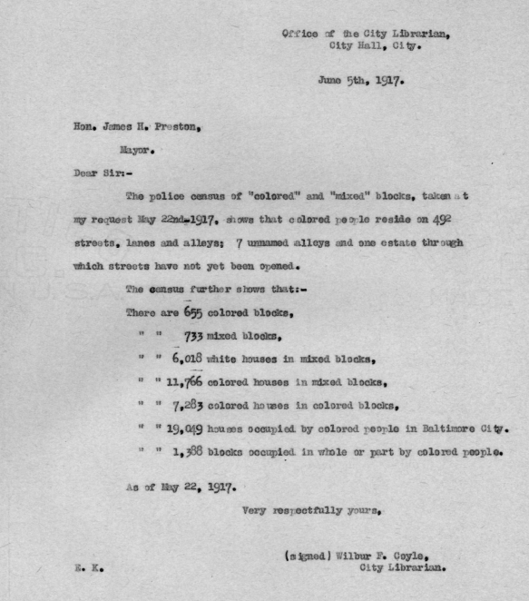
“Block” Segregation in Baltimore
Notes:
As of June 5, 1917- survey ordered by the mayor
-655 colored blocks
-733 mixed blocks

Slide 13
Case Facts
Thomas S. Jackson entered into a contract to purchase a house on the corner of Mount and Baker streets
Sources: Appellant’s brief in the Court of App, October Term 1915;
Criminal Court Transcript of Record
Notes:
-Thomas S jackson, black man
-entered into a K w real estate broker Charles Morton to buy the house from Mrs. Amanda Bagnall (white woman)
-SE corner of Mount and Baker streets
-Purchase price $1050
-made the $25 deposit and started living there
-front of house faces Mount St (block inhabited entirely by white people)
-but the entrance is in the back, on baker St (block inhabited totally by black people)
-D indicted on 2 counts on December 15, 1914.
1) that he used the property as a dwelling
2) that he occupied the property as a place of abode and residence

Slide 14
House Entrance
House Facade

Slide 15
Jackson- before the decision
Filed for a demurrer to the indictments on the basis that the ordinance violated the 14th and 15th Amendments
Entered special pleas
Found guilty, fined $5
Sources: Appellant’s brief in the Court of App, October Term 1915;
Criminal Court Transcript of Record;
The Afro 4/3/15 & 4/24/15
Notes:
-demurrer to the indictment, demurrer was overruled by judge stump on April 7, 1915
-submitted a special plea and was found guilty on May 19, 1915
-special pleas set up 2 defenses:
-that the person jackson bought the property from owned it before the ordinance (therefore she had vested property rights before the ordinance was passed and the ordinance did not apply to her)
-there was nothing in or near the block or in land records or any city record to give notice to proposed puchasers or tenants that this block or any other block was white or colored.
-Fined $5 + court costs of $59.75
-Filed an appeal with the court of appeals of maryland on May 25, 1915
-Was argued once in front of the court of appeals, then they ordered it be reargued, so that they could wait for the Buchannan decision to be handed down from the supreme court)
-article from afro on april 24, 1915 saying that the constitutionality of the segregation ordinance will be decided by the court of appeals

Slide 16
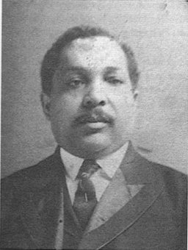
Lawyers
for Jackson
W. Ashbie Hawkins
Cornelius C. Fitzgerald
William C. McCard
for Maryland
W. F. Broening
Horton S. Smith
Edgar Allan Poe
W. Ashbie Hawkins
Source: Appellant brief, October 1915 term MD Court of Appeals
Notes:
African american biography database and who’s who of colored america
Hawkins:
-born 1863, died 1941
-Nationally known lawyer, champion of negro rights
-went to univ of MD law school
CC Fitzgerald:
-Born September 29, 1863 in Jonesboro Tennessee
-died december 15, 1935
-went to Bera college, and graduated from Howard University in 1892
-Married Gurtrude Smith in 1897 nd had one child
-Was the food administrator during world war 1 for Maryland
-President and board of trustees for Provident hospital
-member of the masons
-republican
-office was on 215 St Paul St
-lived on 1103 Madison Ave
-Edgar Allan Poe: went to Princeton, became the attorney general for Maryland (http://www.princeton.edu/pr/pwb/03/1013/2n.shtml)

Slide 17
Segregation Ordinance Coverage: The Baltimore Afro-American
Source: Afro
2/19/16 & 6/22/16
Notes:
On the left is an article from february 19, 1916, the ‘viciously obnoxious’ language shows how angry people were about it
-article on the right is from june 22, 1916, states that NAACP lawyers who have had successes in other cities will be handling the defense of Jackson- shows this may have been part of a coordinated effort

Slide 18
Segregation Ordinance Coverage: The Baltimore Sun
Source: The Baltimore Sun
9/28/10 & 6/25/13
Notes:
Baltimore sun articles- the city wants the ordinance to pass; it’ll be beneficial for both races

Slide 19
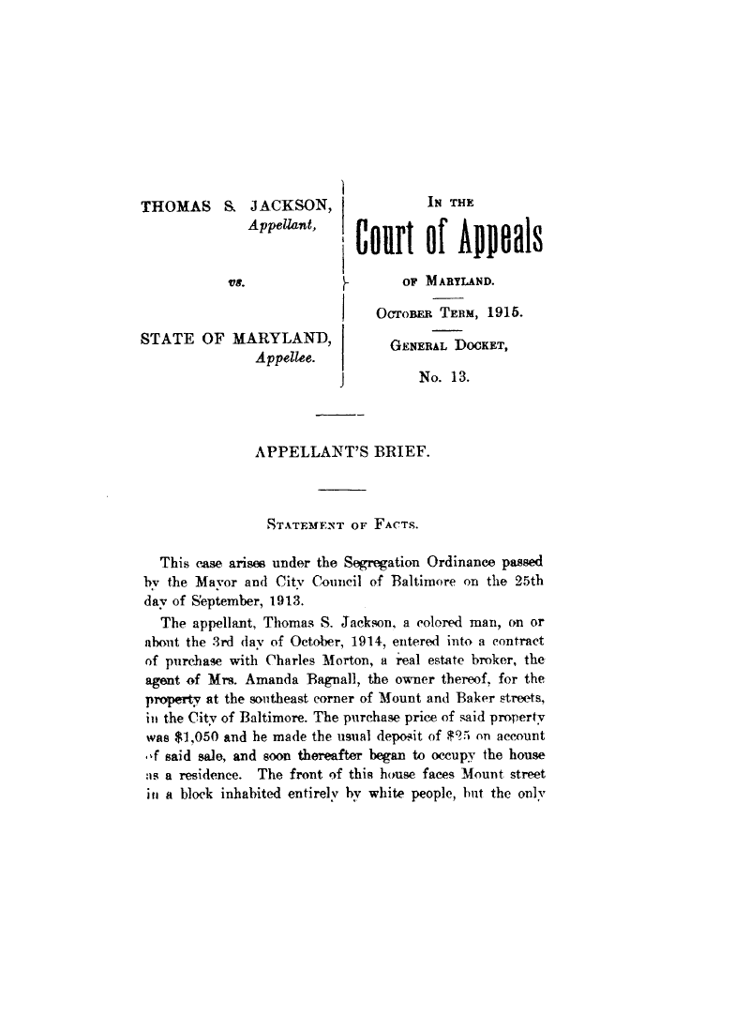
Jackson- Court of Appeals Arguments
Appellant (Jackson)
No notice of which blocks are white and which are black
Drives up cost of housing for blacks
Decreases value of housing owned by whites
Improper use of police power
Violation of 14th Amendment
Source: Appellant brief, October 1915 term MD Court of Appeals
Notes:
Jackson:
-Ordinance in the Gurry case was found invalid bc it didn’t address vested property rights or give notice of what blocks were white and what blocks were black
-doesn’t take into account any right other than the right to occupy a residence
-This case is a good illustration of why the ordinance doesn’t work: the house at issue faces a white block, but has an entrance facing a black block. It had remained empty for a while, at a loss to its owner.
-no white person wants to have it bc its entrance is on a black block, and no black person wants to rent it because they fear prosecution (because it faces a white block).
-as soon as it was occupied by a black person, white neighbors made sure he was prosecuted under the ordinance
-tries to exempt mixed blocks, but the fact that they’re doing fine shows this ordinance is unnecessary, they’re doing fine
-makes homes in colored blocks more expensive to buy and rent: as the court said in Gurry, white people own the great bulk of property in bmore city. Most places where they now reside are white blocks. Colored people can’t occupy these, so it restricts black people to the blocks where they already reside= less supply of black housing= large demand for real estate in these sections = greatly increased rent and purchasing prices.
-police power can only be used by the stat when it is operating to the benefit of all individuals, equally
-From the supreme court case of Sprigg vs. Garrett Park: if a statute is supposed to help the public good, it Is uncons if:
1) it has no substantial relationship to its goals
2) it is an invasion of fundamental rights
-14A prohibits legislation which affects only 1 class of people
-liberty is more than just not being in jail, you should be able to do what you want with your property
-compare it to San Francisco ordinance passed in 1890 that attempted to segregate the Chinese living in the city- in re Lee Sing
-district court ruled it was unconstitutional, bc it was discriminating and unequal in its operation and an arbitrary confiscation of property without due process of law
-Segregation ordinances enacted after the Bmore ordinance in N Carolina and Georgia were held invalid. (State v Darnell and Carey v Atlanta)
-

Slide 20
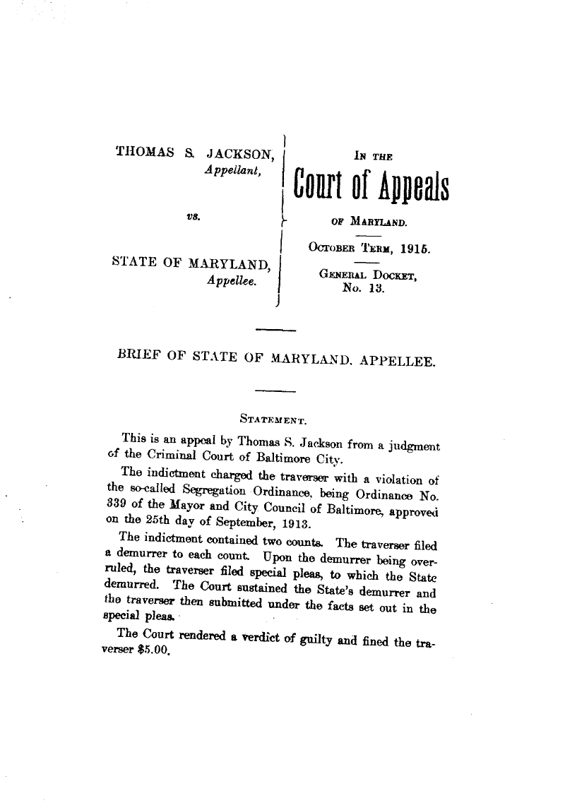
Jackson- Court of Appeals Arguments
Maryland
The new ordinances fix the problems with the Gurry ordinance
Jackson did not have a vested property interest when the ordinance was passed
The state doesn’t have to give as to whether a block is black or white
Source: Appellee brief, October 1915 term MD Court of Appeals
Notes:
Maryland: entrance to the house was changed from the baker to mount st side in order to allow Jackson to claim the house was in a colored block (Afro 4/3/15)
-Was formulated to fix the problems that the gurry court pointed out- the only reason that the gurry ordinance was overturned (in the state’s view), was that it failed to provide an exception for property rights already vested.
-This ordinance has an exception for people who already have a right to occupy
In response to the defenses set up in jackson’s special pleas:
-the proceeding is not against the person who owned the house when the ordinance was passed, so the vested interest argument is not a defense
-In response to Jackson’s argument that there was no notice bc the city didn’t produce anything that identified blocks as either black blocks or white blocks– the ordinance was in place for a year before Jackson moved in, he had fair notice
-also, every tenant or purchaser is presumed to have notice of things he could learn upon inspection of the area - he could have asked anyone on the block or just looked around
- the purchaser bears the risk of getting it wrong
-there’s no legal reason that the city should have to provide a list of what is a colored block and what is a white block

Slide 21
Buchannan v. Warley
Louisville, Kentucky
“An ordinance to prevent conflict and ill-feeling between the white and colored races in the City of Louisville, and to preserve the public peace and promote the general welfare by making reasonable provisions requiring, as far as practicable, the use of separate blocks for residences, places of abode and places of assembly by white and colored people respectively.”
White seller sued black buyer
Buyer defense: ordinance prevented a black person from buying the lot in question
Seller: The ordinance is unconstitutional, therefore no bar to buyer’s performance
Sources: Buchanan v. Warley, 245 U.S. 60;
JimCrowHistory.org
Notes:
-Press indicated that the buyer and seller colluded to bring this case
-Seller sold house to buyer on a contract that included a clause saying that the buyer intended to use the house as a dwelling and he would not be required to pay if laws prohibited him from doing so
-the house was on a white block, so he couldn’t live in it, refused to perform on the contract and the buyer sued him for performance
-Ordinance:
-Section 1: unlawful for a black person to live in or make a place of assembly any house in any block where more houses are residences or places of assembly for white people. And vice versa.
-Had a clause in it protecting vested property rights- anyone who had a right to occupy before the ordinance was passed can continue to occupy
-and of course an exception for servants
-if a house is leased to a colored person, cannot then lease it to a white person. And vice versa
-Kentucky court of appeals: found the ordinance was constitutional. Appellant sought review

Slide 22
Baltimore’s amicus brief
S.S. Field: City solicitor for Baltimore City
Authored brief
Notes:
Submitted an amiucs brief in the Buchanan case, as it was clear that the decision would affect the consitutionality of their ordinance

Slide 23
Buchanan v. Warley
Decided November 5, 1917
Illegitimate use of police power
Regulation of property rights violates Due Process Clause of the 14th Amendment
Ordinance unconstitutional
Source: Buchanan v. Warley, 245 U.S. 60;
Afro 11/17/17
Notes:
-court’s opinioin:
-police power of a state is broad, but still has to be within the limits of the constitution
-the prohibition is based wholly on color and nothing more
-other segregation laws:
-This segregation law: destroyed the right of an individual to acquire, enjoy and dispose of his
14A requires due process before one can be deprived of property (including the right to acquire, use and dispose of it)
-Also the 14A was designed to ensure blacks enjoyed all the same civil rights under the law as are enjoyed by white people, and to protect those rights when they are denied by the states
-when it comes down to it, this case isn’t an attempt to prohibit the amalgamation of the races, it’s about a law that annuled the right of citizens to dispose of their property to who they want
-reversed, held unconstitutional
-Afro headline from november 17, 1917

Slide 24
S.S. Field on the Buchanan decision
“The Constitutionality of Segregation Ordinances”
Virginia Law Review
November 1917
Source: Virginia Law Review November 1917
Notes:
ADD NOTES

Slide 25
William T. Coleman
Had been arrested under ordinance No. 339
Filed a writ of habeas corpus
Released without a written opinion
Source: Writ of Habeas Corpus filed on behalf of William Coleman
Notes:
Meanwhile, in maryland…
Filed writ arguing that the ordinance he had been arrested under was unconstitutional
-Judge Rose in the federal district court for the district of maryland granted the writ after Buchanan was handed down, without a written opinion

Slide 26
Jackson v. State
Decided February 27, 1918
Don’t have to decide if this ordinance fixes the problems we pointed out in Gurry
Since that case, the US Supreme Court decided Buchanan
Jackson opinion is almost all quotes from Buchanan
Ordinance declared unconstitutional
Source: Jackson v. State, 132 Md. 311
Notes:
-2 page opinion , mostly quotes from buchanan
-discuss Buchanan, showing that the ordinance struck down in that case was of the same character as the Baltimore ordinance
-Includes quote from Carey v City of Atlanta: “the effect of the ordinance… was not merely to regulate a business or the like, but was to destroy the right of the individual to acquire, enjoy, and dispose of his property. Being of this character, it was void as being opposed to the due process clause of the constitution.”
-MD court recognizes that the supreme court has held that the right of the individual citizen to acquire or use property cannot be validly restricted by state or municipality on the ground of his color.
-the principle is broad enough to invalidate any ordinance that seeks to limit where a person can live based on race

Slide 27
Press coverage of Jackson
jk
Source: Baltimore Sun 2/28/18;
The Afro 3/1/18
Notes:
-on left, afro march 1, 1918
-n right, baltimore sun february 28, 1918

