Slide 1
Bernstein vs. Real Estate Commission of Maryland
Natalie Waryck and
Heather Steven

Slide 2
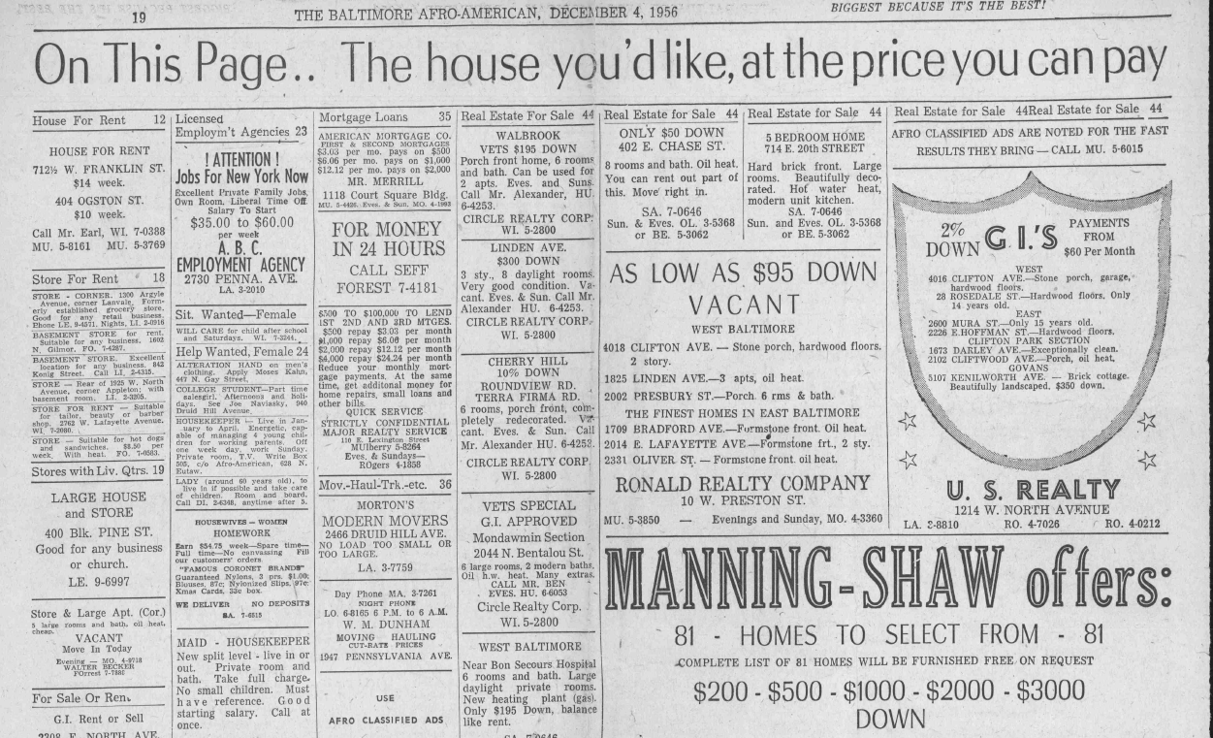
“The House You Want at the Price You Can Pay”

Slide 3
Covenants and Restrictions
Restrictions were set up in Baltimore subdivisions
Was copied in other southern cities
Chicago plan of segregation- real estate boards and restrictive covenants- parties agree not to sell to blacks by contract
Roland Park Company- racial covenants
Door to door petitions
Home Protective Associations

Slide 4
The Ashburton Area Association, an Improvement Association
Allendale- Lynhurst Improvement Association
Similar associations existed in Windsor Hill, Howard Park, and Forest Park

Slide 5
Case History- previous cases
Buchanan v. Warley- 1917- unconstitutional b/c deprives whites of property rights
Meade v. Deniston- 1937- Thurgood Marshall- lawyer for 2227 Barclay street – a property with a covenant
Shelley v. Kraemer- 1948- St. Louis

Slide 6
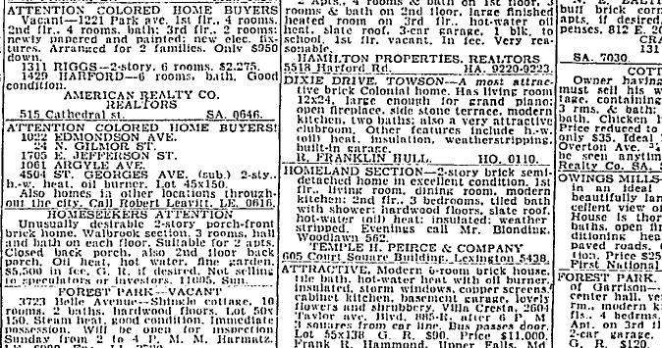
The Baltimore Sun. Real Estate Listings. May 3, 1945.

Slide 7
Blockbusting
“What the realtors were doing was buying a house for fifteen thousand dollars and almost giving it away to get a black family in, and then they would buy a house for six thousand dollars and sell it for fifteen thousand dollars – that’s how they made money on the deal.”
Alice Hughes, white former resident
Excerpt from pg. 102 Blockbusting in Baltimore: The Edmondson Village Story, Orser.

Slide 8
Blockbusting
What is blockbusting?
A practice that involves convincing whites that their previously segregated neighborhood is being overrun by minorities so that they sell at low prices
How did it play out in Baltimore?
There were a number of real estate firms, notably Goldseker, that specialized in selling to African Americans in changing neighborhoods

Slide 9
Redlining and Racial Steering- other issues
Redlining is the policy of denying or charging higher prices for banking or insurance based on the part of town the applicant lives in
Racial steering is when a realtor guides a househunter towards or away from a neighborhood based on his/her race

Slide 10
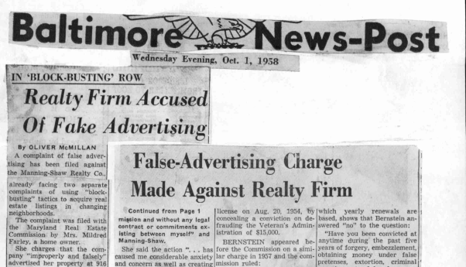
Press Coverage
Newspapers covered this case and the issue of blockbusting extensively
Very negative depictions of firms accused of the
practice
Protests were covered

Slide 11
Press Coverage
Protest in front of Morris Goldseker's Real Estate Company. The Baltimore Sun, August 9, 1969.

Slide 12
Proposed Solutions
Many people, black and white, proposed Baltimore institute a quota system within certain neighborhoods- Morgan seminar
None of the witnesses admitted that they were bigots, but felt that most were
Some wanted education and seminars in tolerance

Slide 13
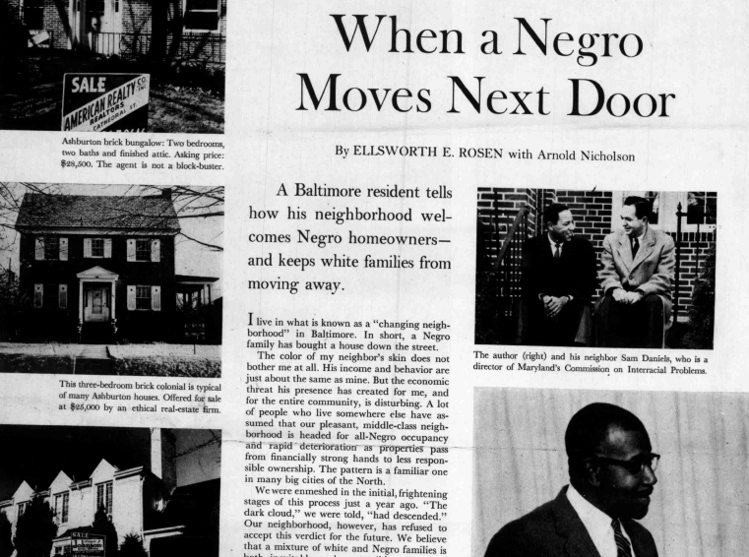

Slide 14
Population Shifts in West Baltimore
Census data- 1960
“Changing Neighborhoods”- Walbrook, Fairmount, Forest Park, Ashburton

Slide 15
Overall Baltimore Population Data

Slide 16
Maps from W. Edward Orser’s book, Blockbusting in Baltimore: The
Edmondson Village Story. (University Press of Kentucky, 1994)

Slide 19
Civil Rights Context
Post- WWII civil rights movement
Issues of inequality
Importance of Baltimore

Slide 20
Integrating Baltimore’s Schools
1954- Brown v Board

Slide 21
Ashburton
Gittings farm until 1919
Sold to residential developer George R. Morris
Single family homes and some rowhouses

Slide 22
3800 Grantley Rd.
Sold for $18,000 and $120 ground rent

Slide 23
3800 Grantley Rd.

Slide 24
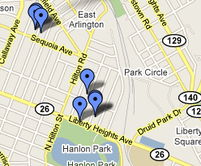
Joseph Carter
Held out to be the buyer of 3800 Grantley
8 Children with current wife, 17 total- lied under oath
Earned $54.62 per week as a janitor, BUT paid $37 per week for 3800 Grantley and $20 per week for another property
Questions about whether he
could afford the house-
Dining room furniture

Slide 25
Manuel Bernstein
City College graduate and earned a business degree from UB
WWII veteran
Convicted felon, defrauded government on dance lessons
Lied on Realtor License application

Slide 26
Bernard Shaw
Face of the enterprise
Arrested at civil rights demonstrations
Remembered as arrogant and conniving
Jailed for contempt for not paying child support
1970 convicted of larceny

Slide 27
Melvin J. Sykes
Harvard University, LL.B., magna cum laude, 1948
Johns Hopkins University, A.B., with honor, 1943
Co-Translator: Jewish Law, Elon; History, Sources, Principles (4 Vols., JPS, 1994)
Incorporated Baltimore Neighborhoods, Inc.
Represented Ashburton and Allendale neighborhood associations

Slide 28
Defense Lawyer
J Calvin Carney
Wright & Cohen in Annapolis
Practiced with his son

Slide 29
Timeline of Case
February 3, 1859-
Before Real Estate Commission of MD
February 25, 1959-
Before Real Estate Commission of MD
Baltimore city Circuit Ct. (these records are destroyed)
Dec 18, 1959-
Ct. of Appeals
June 1960-
Filed appeal to US Supreme Ct.- was denied
June 30, 1960-
Appeal back to MD Ct of Appeals

Slide 30
Facts of the Case
Appeal decisions of two cases from hearings of the Real Estate Commission of Maryland
First case found that Manning-Shaw was using a sale contract without a termination date
Second case found misrepresentation in the sale of 3800 Grantley Road

Slide 31
Legal Arguments
Neighborhood Associations and Real Estate Commission
Manning-Shaw
Charged with misrepresentation, misleading advertising, “bad faith, incompetency or untrustworthiness, or dishonest, fraudulent, or improper dealings”
Charged with accepting a listing contract that did not have a definite termination date without notice from either party
Alleged that Berstein obtained his real estate license fraudulently, but did not decide that matter
The complaints “constituted an unlawful conspiracy against the civil rights of [the brokers] and their customers in that . . . They were charged with ‘blockbusting’ and that the complaints were intended to prevent negroes from purchasing and occupying homes of their own selection”
Also claimed that “if” there were violations, that the brokers acted in good faith, not deliberate

Slide 32
The Ruling
There was sufficient evidence to revoke the real estate licenses
The ruling remained consistent throughout each appeal

Slide 33
Questions?

